Slide 1
Week 7 – Revision Control, Branch management, Deployment
Michael Dempewolf
December 1, 2016

Slide 2

Agenda
Review (5 minutes)
Revision Control (10 minutes)
Branch Management (15 minutes)
Deployment (10 minutes)
Project Status Updates (30 minutes)
Prepare for Presentation & Final

Slide 3

Review
What is a sprint retrospective?
How do we manage quality?
What is the definition of done?

Slide 4
Revision Control
What is it?
Why do we use it?
Examples?

Slide 5
Branch Management
What is branch management?
Why do we need it?
How do we use it?

Slide 6
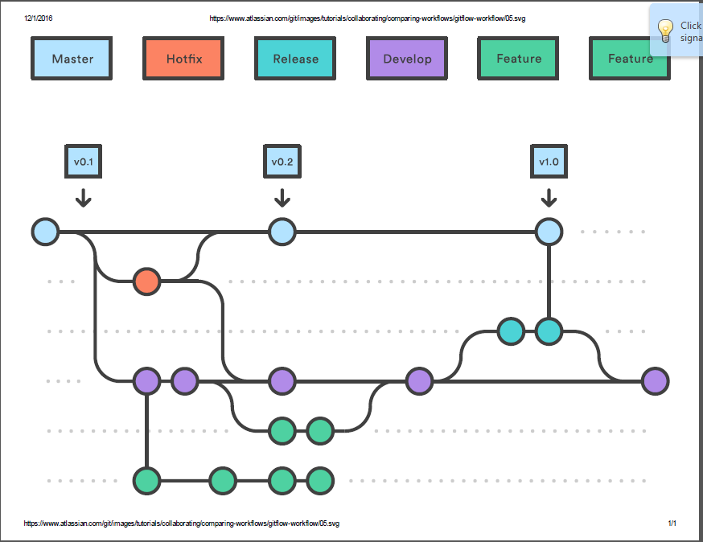
Branch management (Cont)

Slide 7
Deployment
What is deployment?
How do we deploy a system?
What tools do we need?

Slide 8
Deployment (cont)
Revision/Version Control System
Build Server (Preferably CI & Full builds)
Release Build (version & label)
Packaging
Installation
Training
Support

Slide 9
Conclusion
Use Revision/Version Control to manage code/releases
Use Branch Management to manage releases, hotfixes, new projects/features
Deployment leverages multiple tools to deliver system to end user

Slide 10

Questions

Slide 11
References:
Question mark = http://www.agile-code.com/blog/easy-task-estimation-with-three-point-estimation-technique/
Branch Management = https://www.atlassian.com/git/images/tutorials/collaborating/comparing-workflows/gitflow-workflow/05.svg

Slide 12
Questions for you
What do you do when you deploy a release and find a major issue with it?
How do you fix an issue a client is having with the system 2 releases ago?
How do you handle adding a new project?

